Slide 1
Training an agent using neural networks
ID1214 Project
by Perttu Jääskeläinen & Evan Saboo

Slide 2
Introduction
General idea
Neural network
NEAT (Neuroevolution of augmenting topologies)
Notes:
GENERAL IDEA
Agent, which can navigate in a Snake-like map but without growing
Types of possible solutions to teach the agent - neural net
The NEAT method seemed promising

Slide 3
NEAT
2002, Ken Stanley & Risto Miikkulainen, University of Texas
Genetic algorithm
Alter topologies (adding nodes/connections)
Outperforms the best fixed-topologies
Similar implementations to different games
Notes:
Genetic neural network algorithm
mutation, alter weights randomly
selection, select the best performing genomes
crossover, combine two well-performing genomes
Alter topologies - start with a base structure, add nodes/connections as you go
“Black box” - never know exactly what is going on
According to the paper, outperforms similar GA’s with fixed-toplogies
Implemented for Sonic, Mario

Slide 4
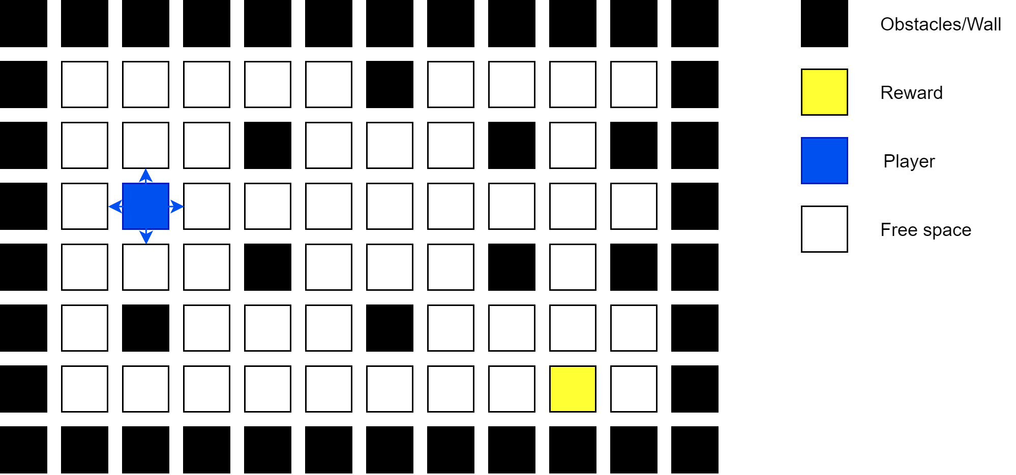
Game design
Map layout
Player movement
Reward
Notes:
Map layout is done as rows and columns, similar to a snake game
The player can move horizontally and vertically
The goal is to reach the reward without colliding with walls
When the goal is reached, it re-locates to a randomized spot on the map (not on walls/player)

Slide 5
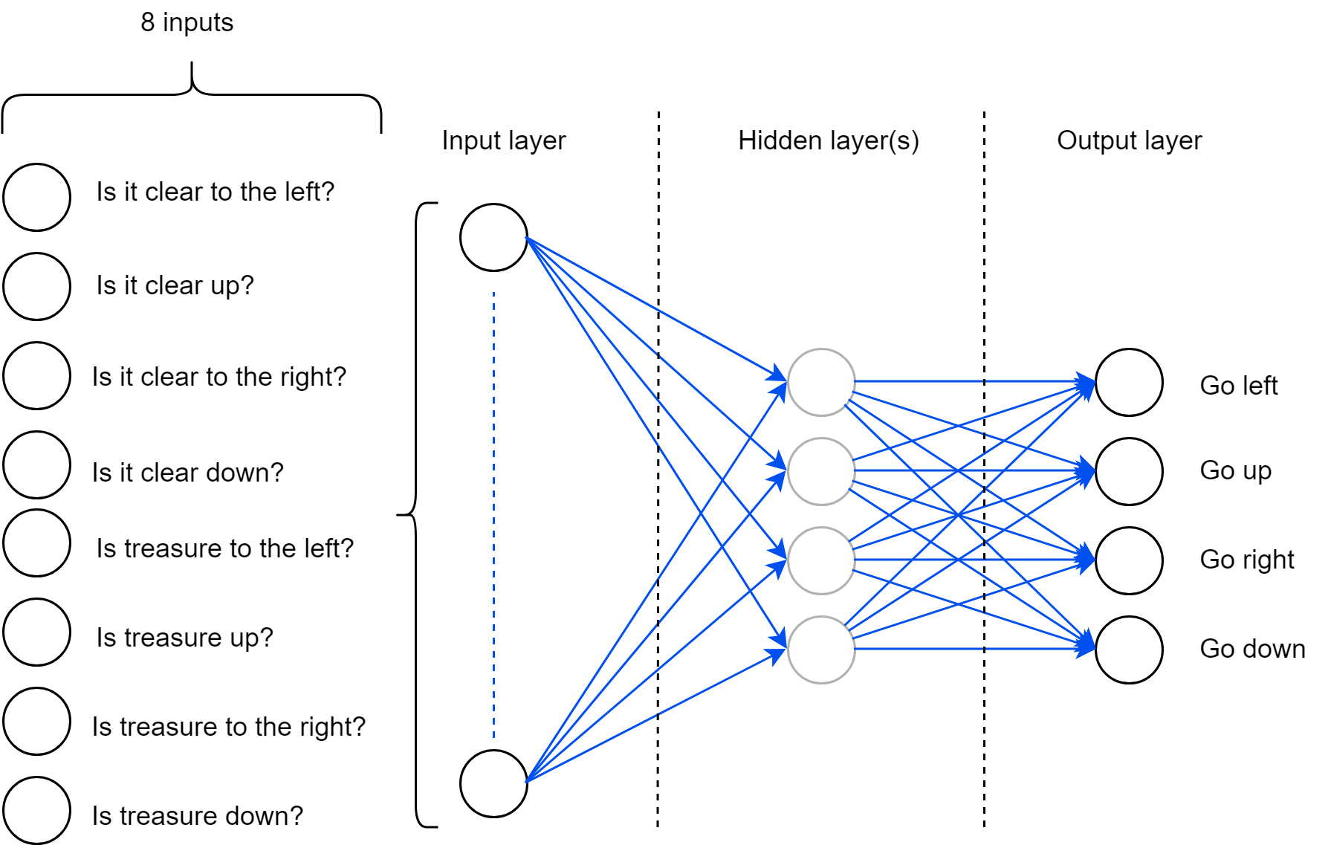
Neural network
Input design
Hidden layer, weights
Output design
Notes:
Input should be so that the player can know each of the free/not free spaces horizontally and vertically
Hidden layer adjusts input with weights, biases (neural network magic)
Next move is chosen from the output that has the highest value (left, up, right, down)

Slide 6
Demonstration and Testing

Slide 7
Discussion
Improvements
Delivery
Notes:
Improvements:
navigate around objects, improved “vision”. Implement enemies.
Training better - focus on specific block structures (1x1, 1x2, 2x1 etc.), instead of combining.
Current problem - moving “around” blocks (2x1 vertical, keeps going up and down)

